Slide 1

FFNN Model tuning

Slide 2
Best model parameters
Learning rate: 0.00011422862586279524
Number of hidden layers: 6
Number of nodes: 1024
optimization: AdamW
activation: relu
L2 regularization: 0.0006956584250323082
Batch size: 2048
Batch normalization: False
Dropout: 0.02980486008161051

Slide 3
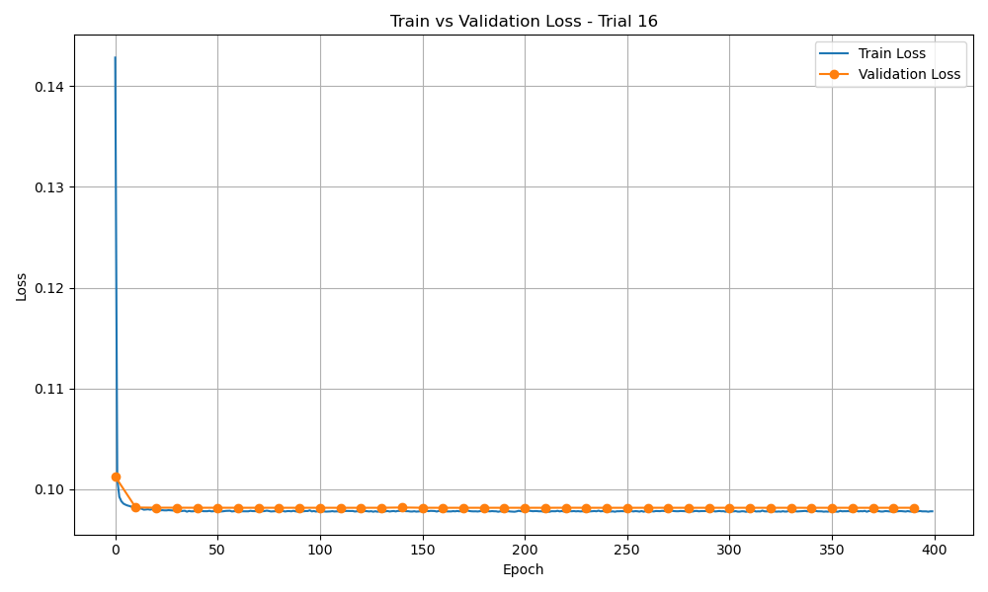
Training and validation loss for best model (trail continuing)

Slide 4
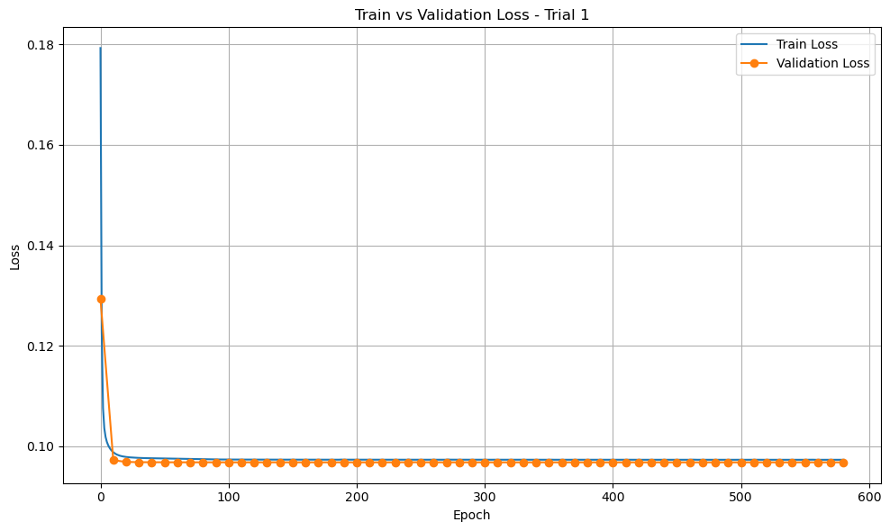
Model tuining (29th July 2025)
Lr = 0.00001272336
N_hidden = 10
N_nodes = 2048
L2 = 0.00084146
Dropout = 0.0882
Bn = True
Batch_size = 1046
Loss = 0.097

Slide 5
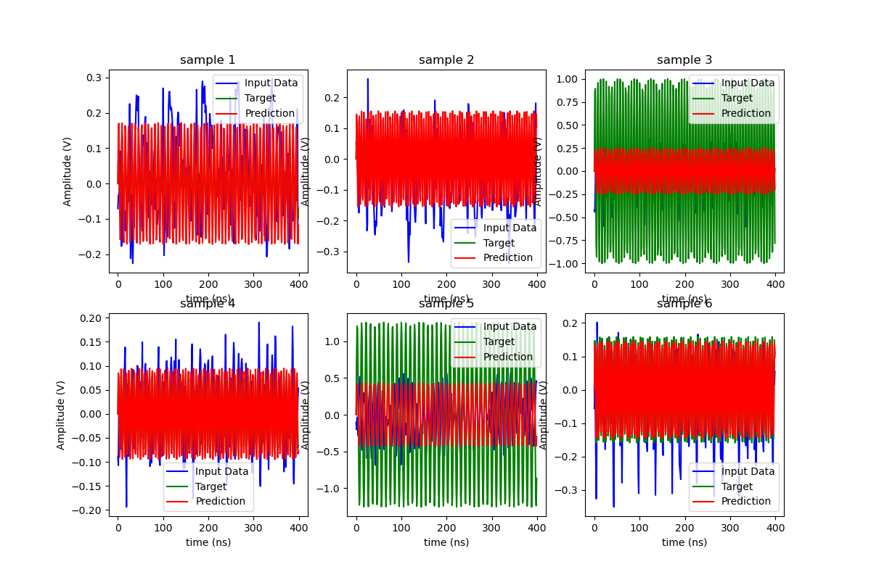
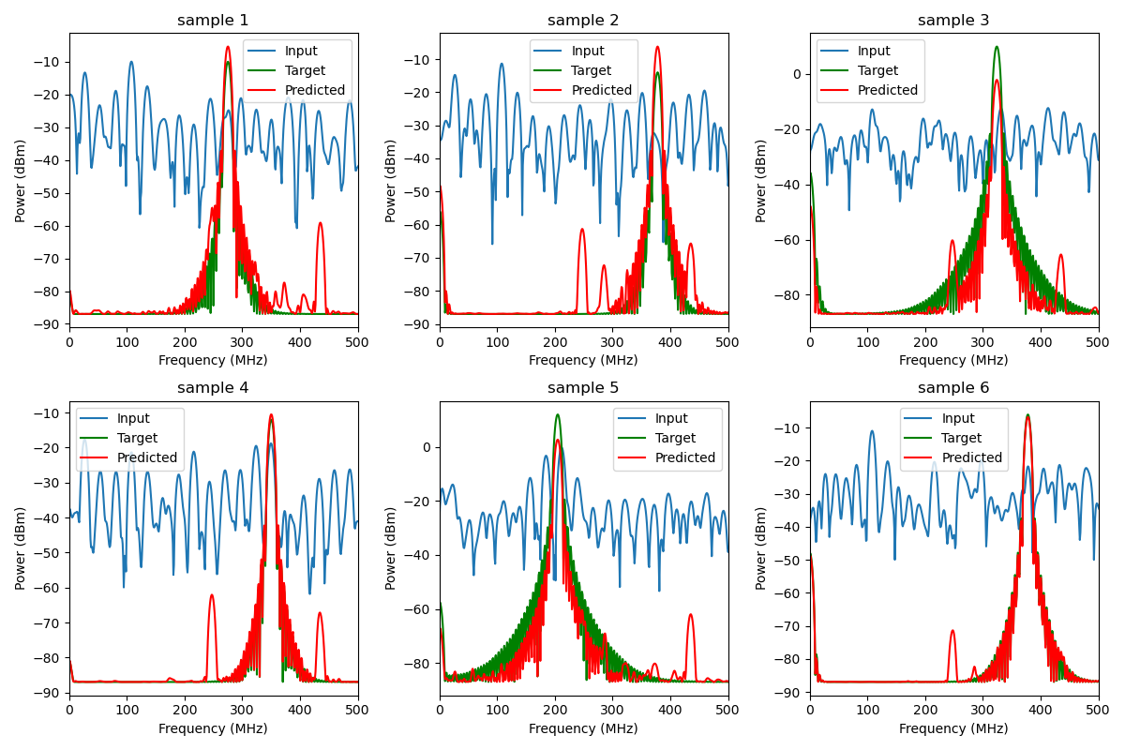
the training sample

Slide 6
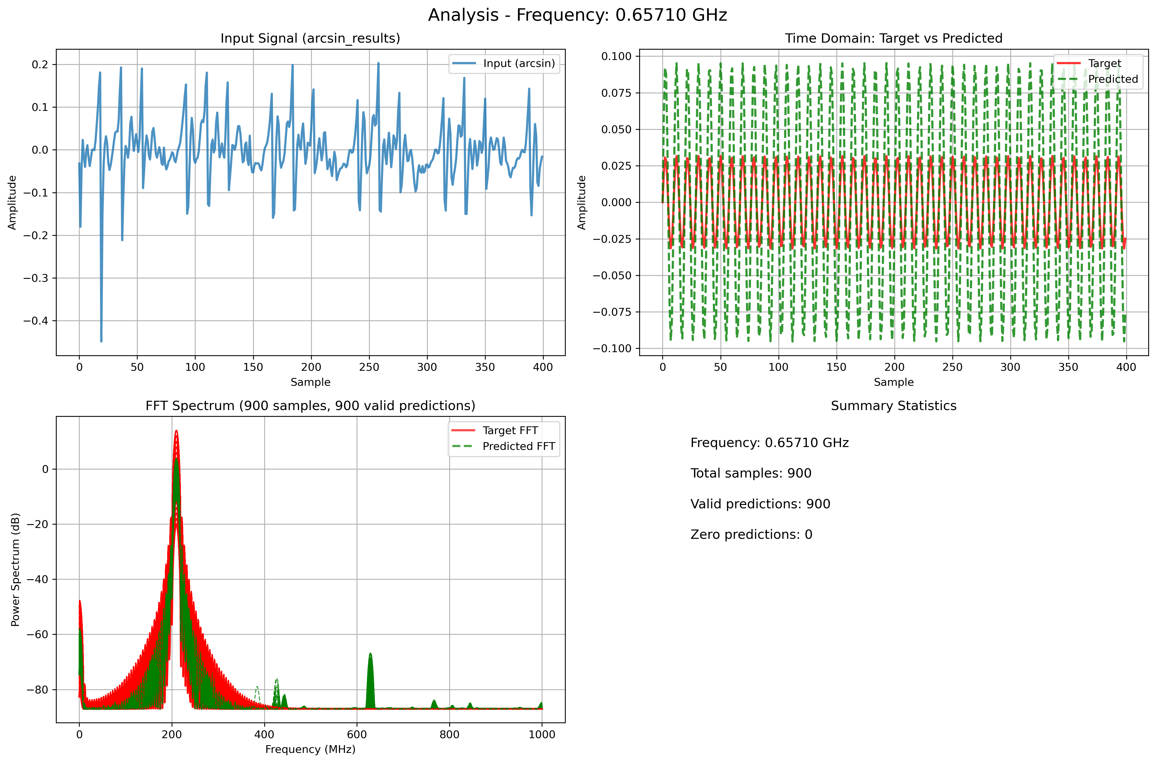
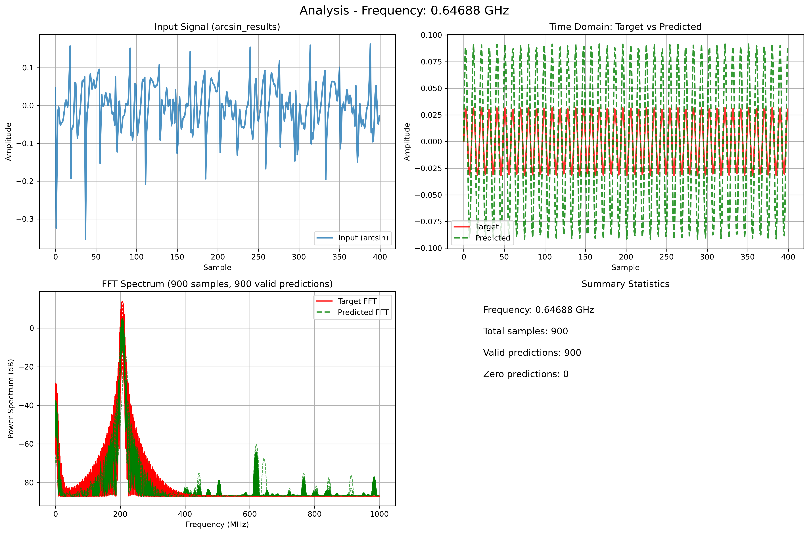
Fft of Testing data

Slide 7
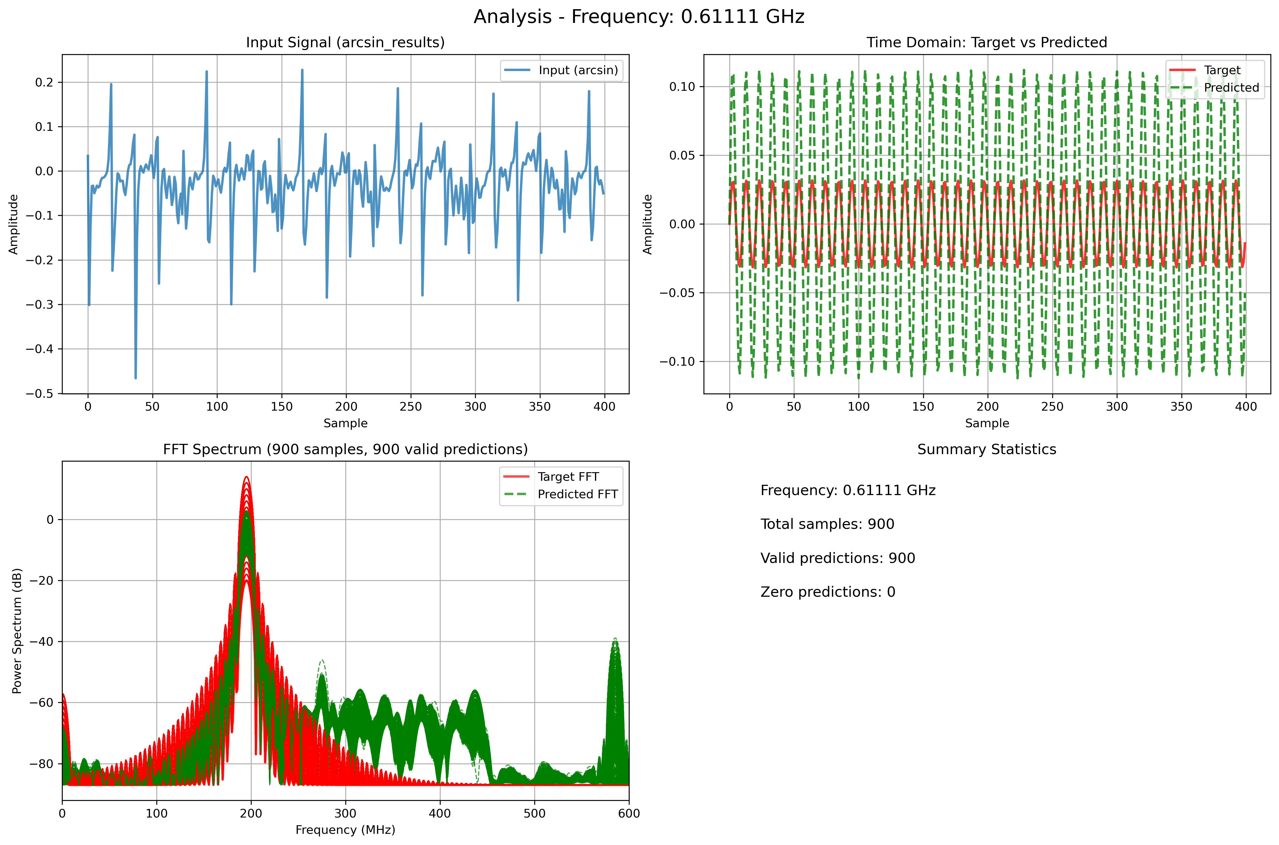
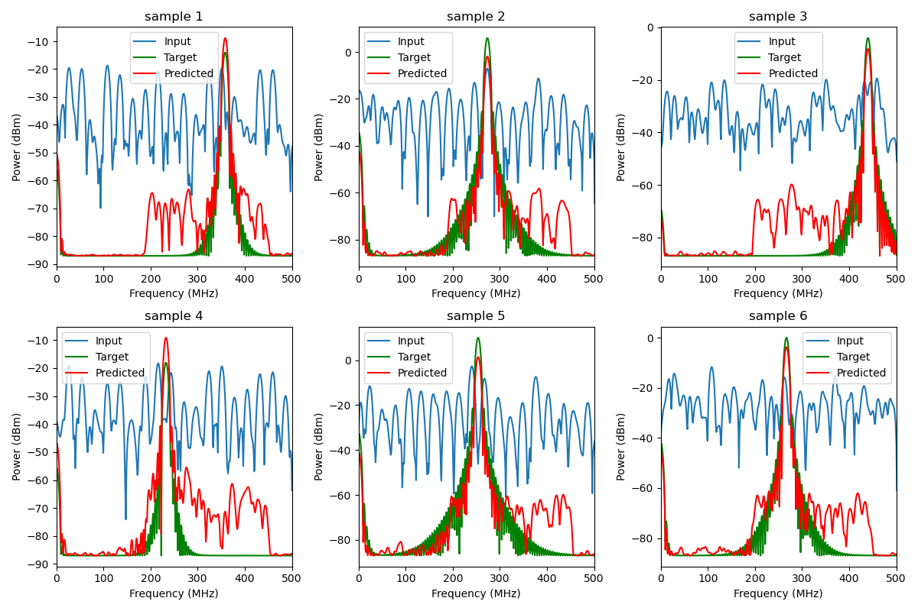
Model tuning (23/07/2025)

Slide 8
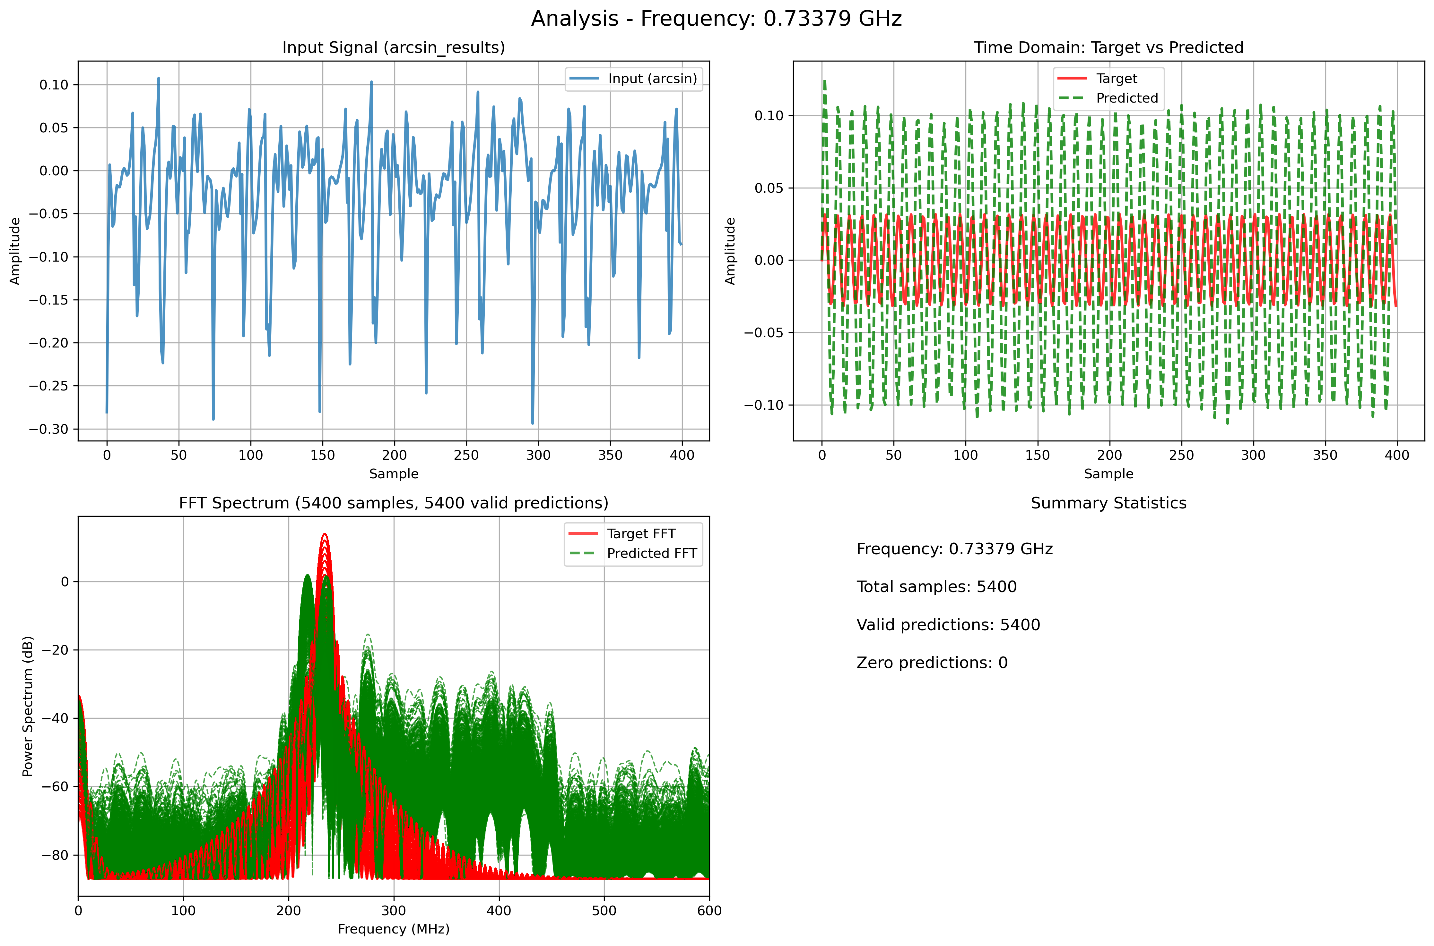
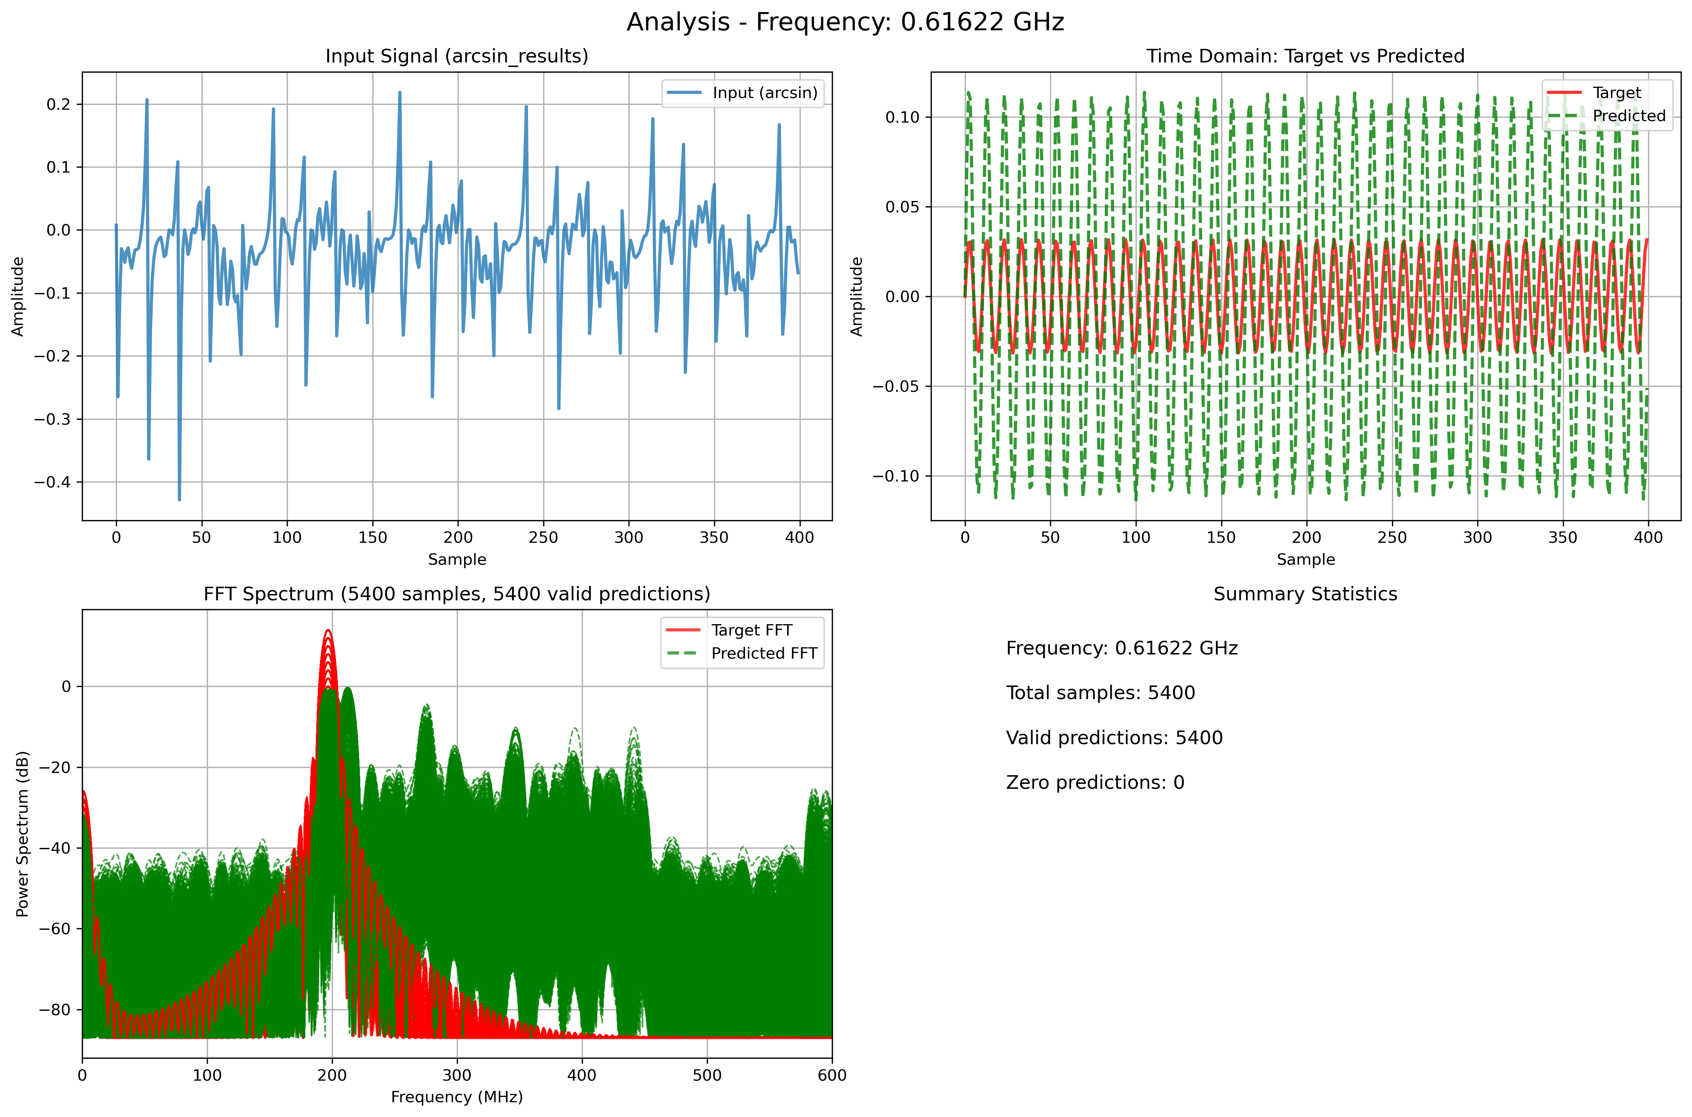
Prediction with offline data

Slide 9
Current trial
Increased nodes
Regularization changed from l2 to l1

Slide 10
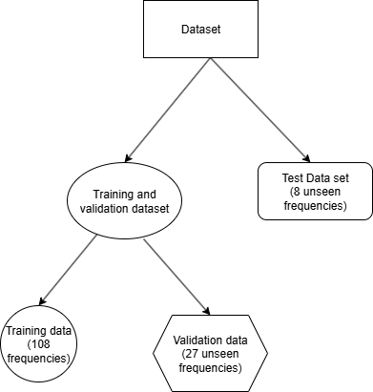
Data splitting for training, validation and testing

Slide 11
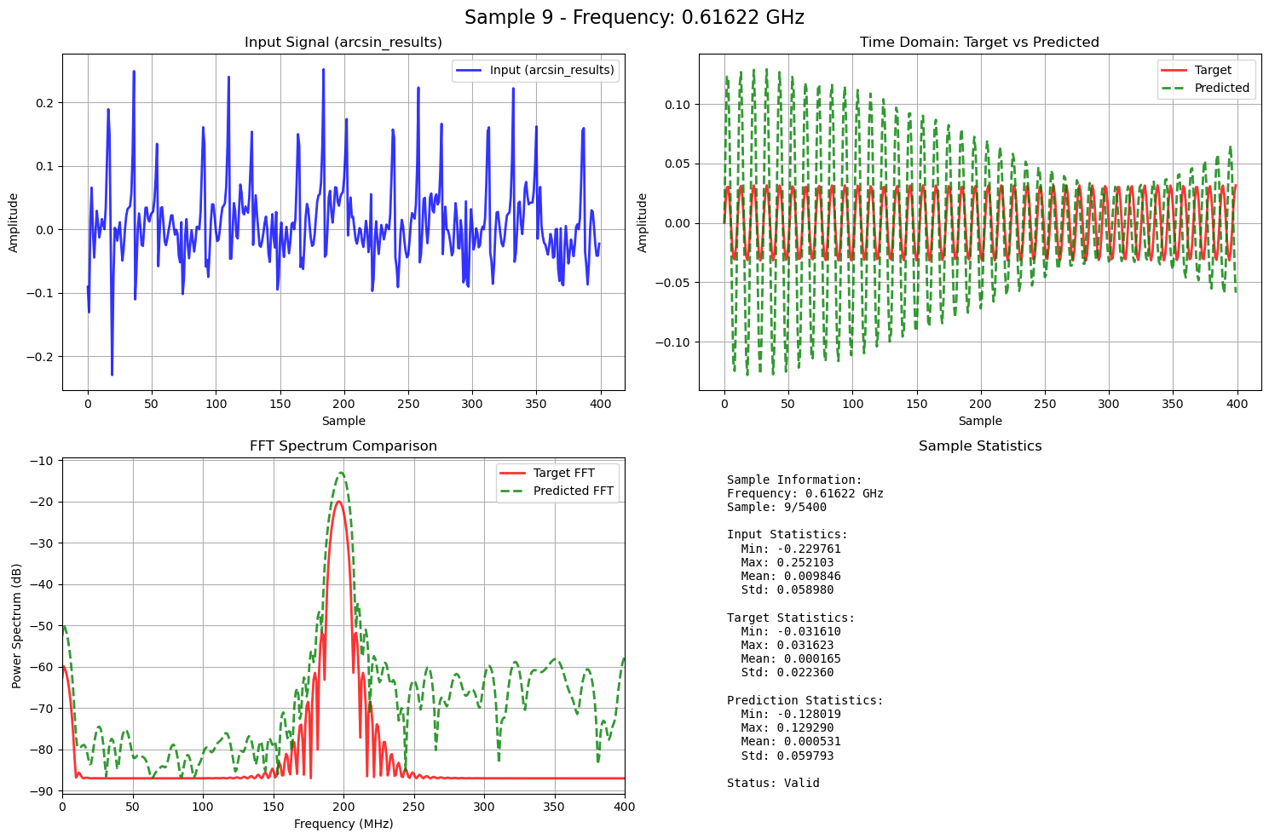
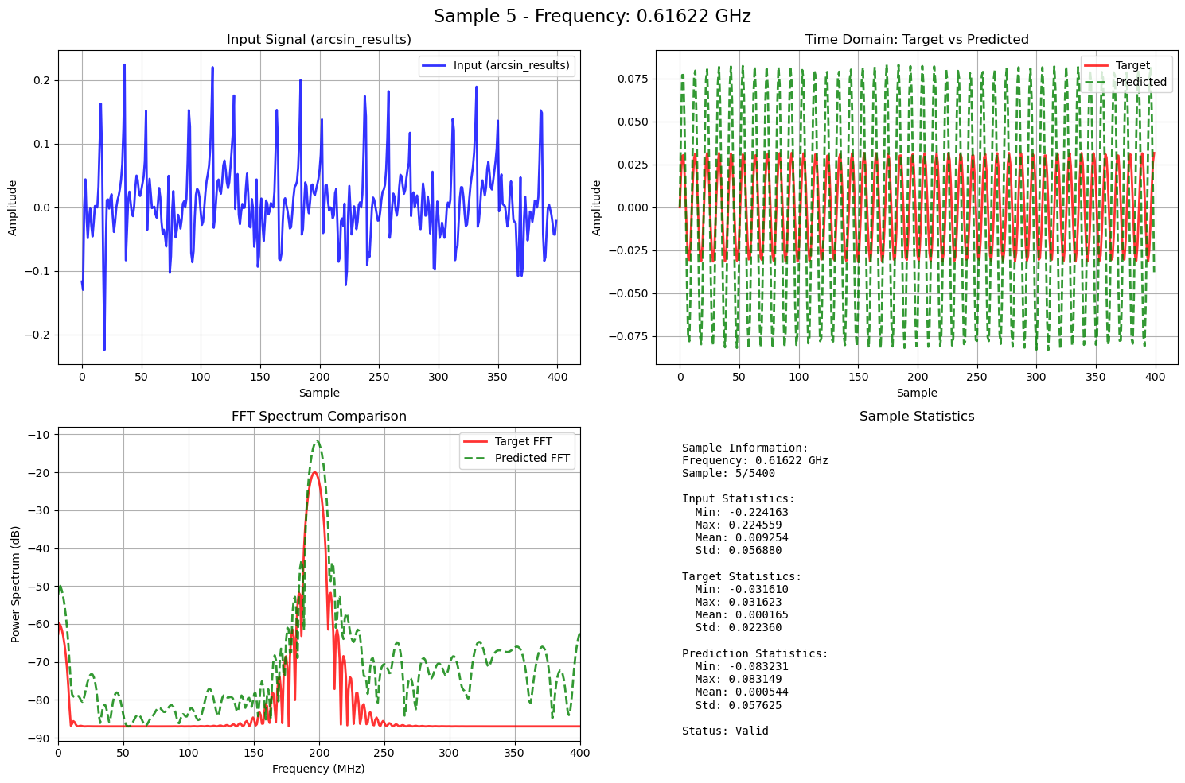

Slide 12
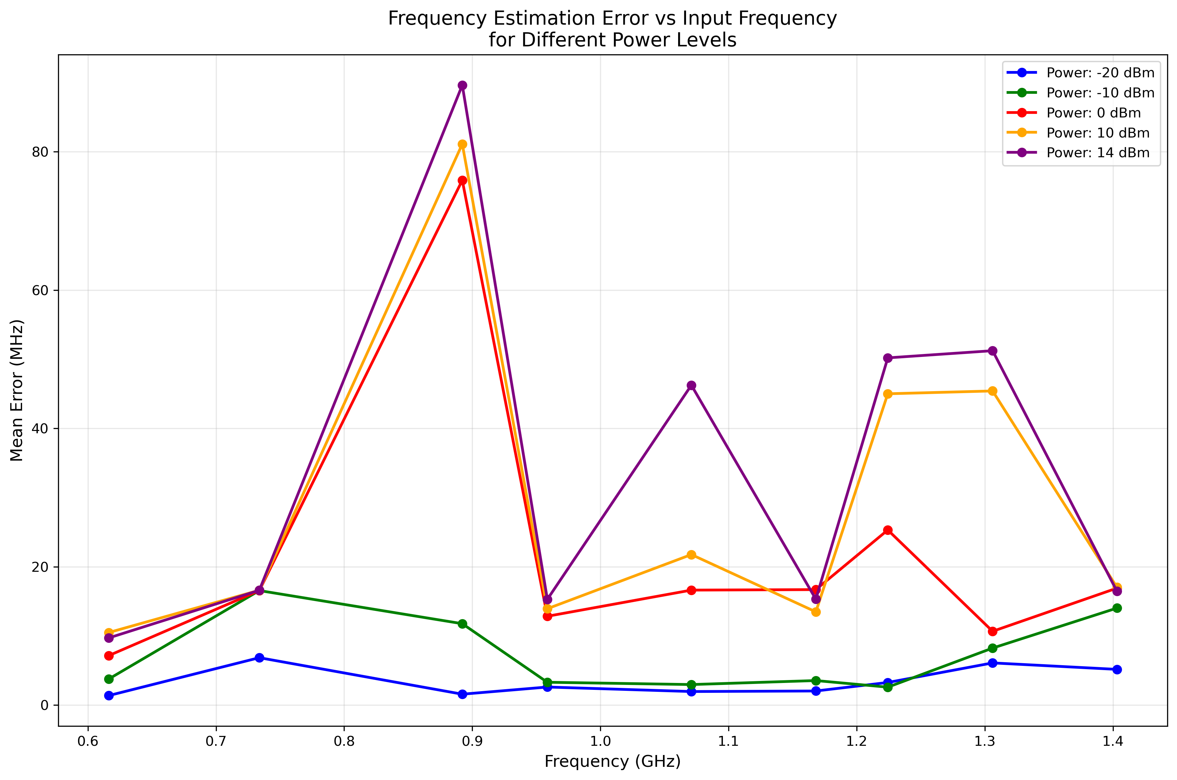
Frequency vs error

